Slide 1
Effect of flexible H2 generation on production cost
THEMAs Technology Outlook:
Robert Seguin, Thema Consulting Group

Slide 2
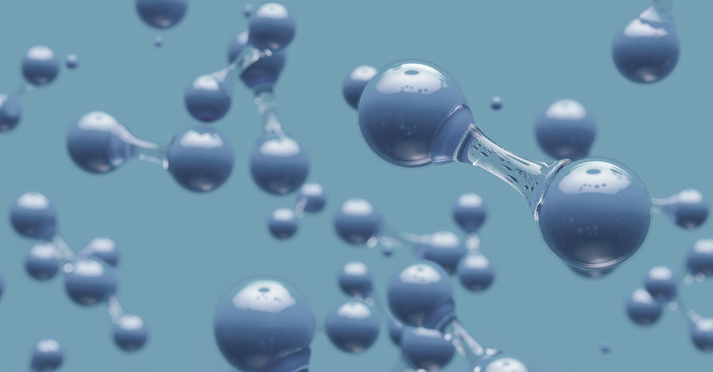
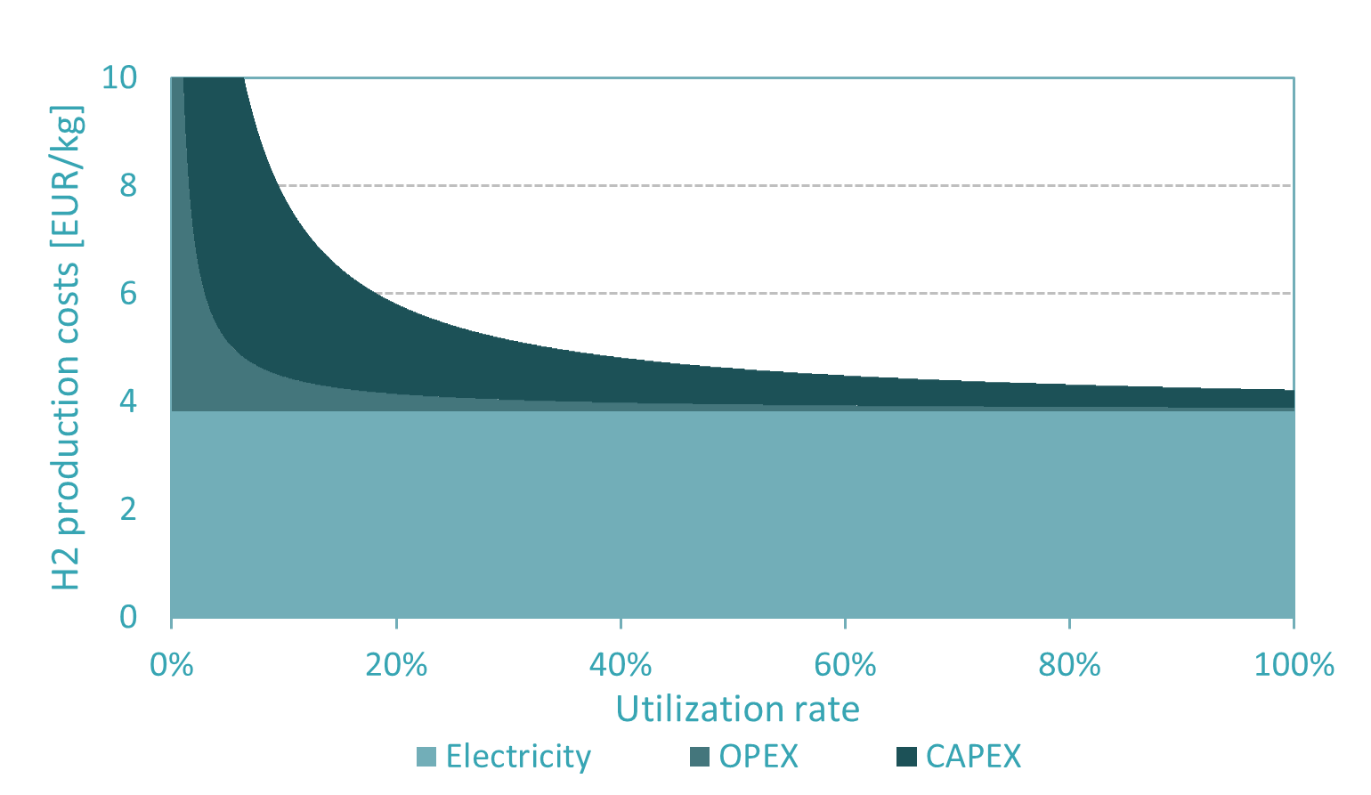
Production costs for green hydrogen are dominated by electricity costs Consider grid-connected electrolysis with spot market electricity prices
Production costs for green H2 dominated by electricity costs
At constant electricity prices high utilization rates are favorable
grid fees, taxes
[EUR/MWh_{electricity}] / [EUR/MW_{electricity}]
annualized CAPEX,
OPEX
[EUR/MW_{capacity}]
70 - 90%
electricity costs
[EUR/MWh_{electricity}]
2030 assumptions : CAPEX=450 kEUR/MW, OPEX=7 kEUR/MW, electricity price=80 EUR/MWh

Slide 3
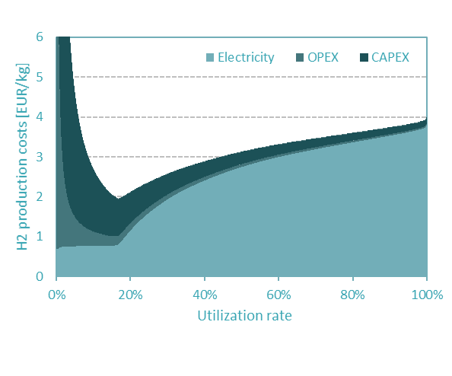
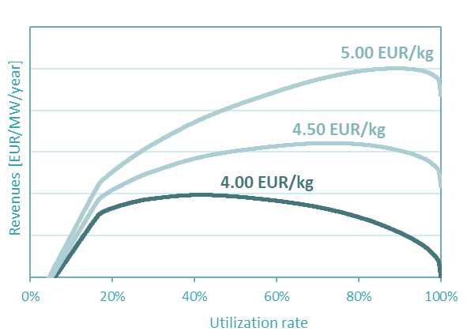
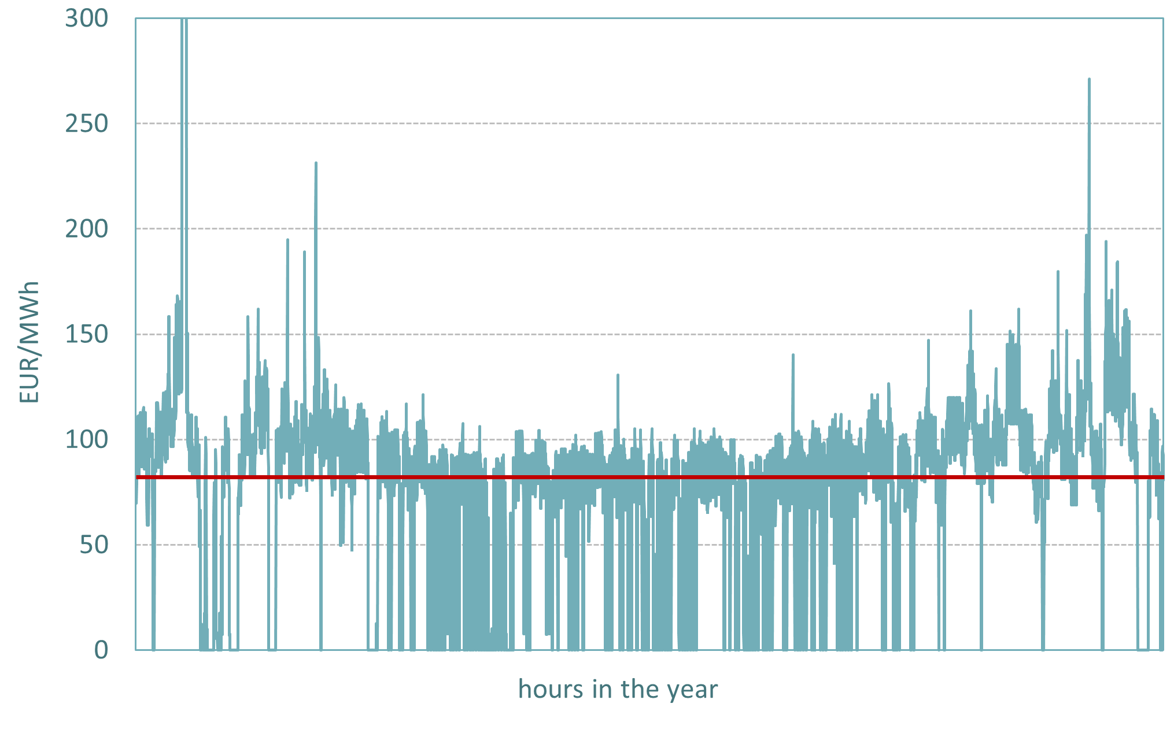
Electricity prices vary – dynamic operation can reduce electricity cost and thus hydrogen production costs
Substantial price volatility
High utilization not always key
Dead projects can become profitable
Example from Germany:
Average price: ~80 EUR/MWh
Lowest price: 0 EUR/MWh
Peak price: >300 EUR/MWh
Production during the lowest-cost hours only:
Cost reduction for electricity outweighs cost increase for CAPEX and OPEX.
Depending on the market value of the H2, lower production volumes at lower production cost per unit can be a profitable option.
THEMA’s recent Market Outlook for Germany in 2030
2030 assumptions : CAPEX=450 kEUR/MW, OPEX=7 kEUR/MW, electricity price=80 EUR/MWh

Slide 4
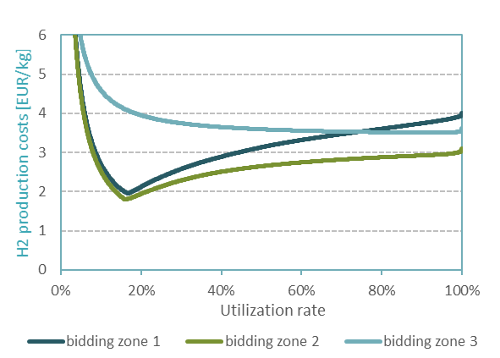
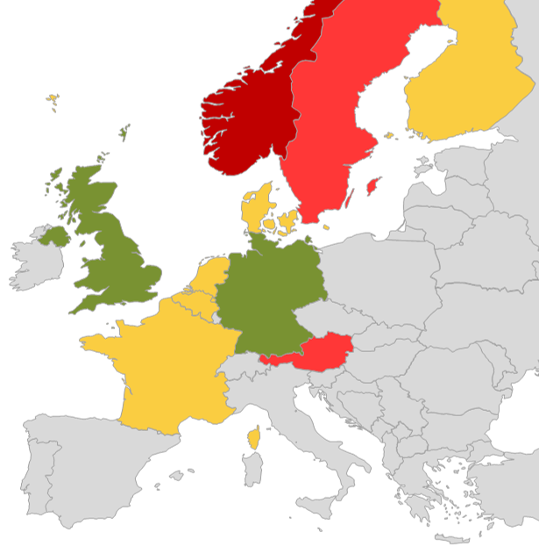
The decrease of costs and overall profits depends on the electricity market environment
Different bidding zones
Strong local variations
Essential market environment factors
Dynamic operation results in very different costs curves in the three bidding zones shown.
Regions with a lot of flexible hydro power have lower cost reduction potential (red color) than regions with little flexibility in the system (green color).
Whether or not flexible operation strategiesare favorable depends on a number of parameters:
Electricity price volatility
Overall price level
Market prices hydrogen
Electrolyser cost parameters
Flexible operation potential
Operation strategy
…
High utilization rates are not always the most profitable solution!

Slide 5
Navigate the energy transition with confidence

