Slide 1
Horizon Europe Clean Hydrogen Partnership JU – calls 2024
Tim Genge
EU advisor
NCP- National Contact Point
CL5 – climate, energy og mobility
Innovation Norway

Slide 2
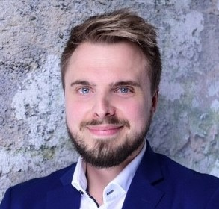
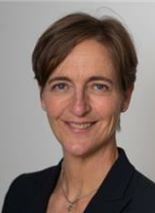
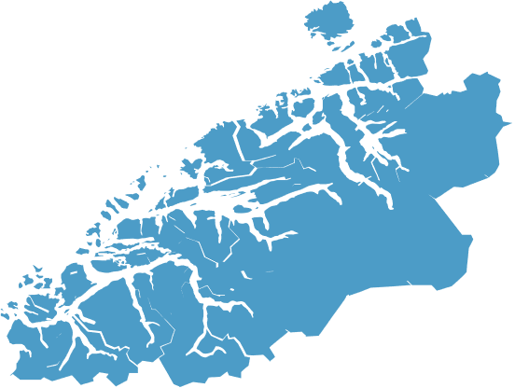
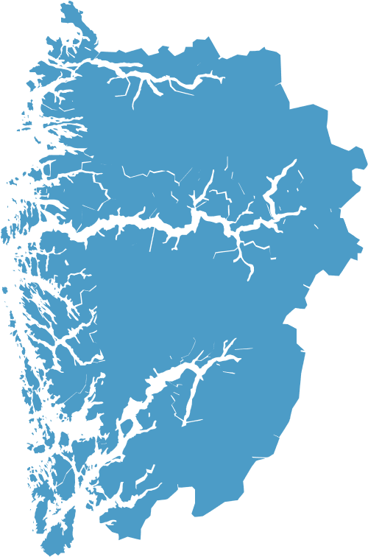
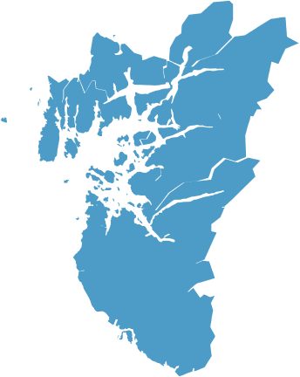
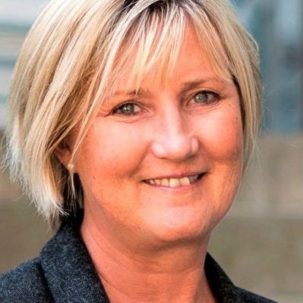
Oslo – regions – Brussels – foreign offices
+ NCP colleagues at the Norwegian Research Council Liste
Inger Elisabeth Strand Karni
Koordinator pilar III
(starter 1.desember)
Espen Warland
Koordinator pilar II +
missions
Ingrid Wiik
Digital/EIT
Helen Gjester
Digital/EDIH
Jens Nielsen
NCP EIC – HEU
Siri Røsberg
NCP EIC/EIE
NCP Risikokap. HEU
Anette Berg
INvest EU
Kerstin Solholm
Cluster 4
Tim Genge
Cluster 5
Greta Karine Juul
Cluster 6
Rosa Maria Correa Rodriguez
COSME+EEN
IPCEI Eva Langslet
Lisbeth Vassaas
NCP EIC – HEU
Kontorleder
Hans Eirik Melandsø
Aleksander Olsen
Trine Smukkestad
NCP EIC – HEU
01.03.24
Greta Juul
NCP EIC – HEU
Kathleen Skabøvig
NCP EIC – HEU
Maria Erdal Askim
NCP EIC – HEU
Trainee
Edel Bertine Dirdal
NCP EIC – HEU
Nils Skarland
EDF
Gunn Astrid Hegna Jansen
NCP EIC – HEU

Slide 3
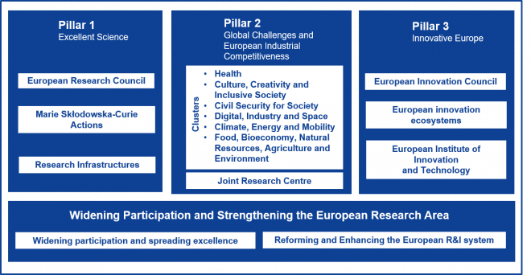
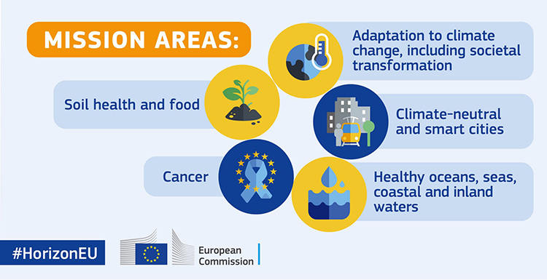
COSME – EU's programme for the Competitiveness of Small and Medium-sized Enterprises is part of EU's Single Market Programme with a €4 billion budget for the programme period of 2021-2027, of which €1 billion is allocated to COSME.
COSME will provide various forms of support to businesses in particular SMEs to:
- foster a favourable business environment and entrepreneurial culture
- facilitate access to markets
- reduce administrative burden
- support uptake of innovation
- address global and societal challenges
Approximately 40% of COSME’s budget is allocated towards the Enterprise Europe Network (EEN). Since its launch in 2008, EEN has played a crucial role in facilitating the access of European SMEs to the Single Market and third country markets and in providing growth-oriented, integrated business and innovation support services to help them compete. Innovation Norway is the national coordinator and provider of EEN services in Norway.
COSME also funds the Joint Cluster Initiatives (EUROCLUSTERS), around 30 cross-sectoral, interdisciplinary and transnational ‘Euroclusters’, that will support the implementation of EU’s New Industrial Strategy and SME Strategy, by building resilience and accelerating Europe’s transition to a green and digital economy.
The promotion of recovery, green growth, employment and well-being across Europe, builds on the successful model of the Investment Plan for Europe, the Juncker Plan. It will bring together, under one roof, the European Fund for Strategic Investments and 13 other EU financial instruments.
Triggering more than €372 bill. in additional investment over the period 2021-27, the InvestEU Programme aims to give an additional boost to sustainable investment, innovation and job creation in Europe.
The InvestEU Programme supports the following 4 main policy areas:
• Sustainable infrastructure
Transport, energy, supply and processing of raw materials, tourism, digital connectivity and access including in rural areas
• Research, innovation and digitisation
Research, product development, innovation activities, transfer of technologies, scaling up of innovative companies
• SMEs
Access to and availability of finance primarily for SMEs (cultural and creative sectors),
SMEs in difficulty significant risks due to the Covid-19 pandemic
• Social investment and skills
Social innovation, health and long-term care, microfinance, more
Bringing digital technology to businesses, citizens and public administrations
Digital technology and infrastructure have a critical role in EU’s citizens lives. The pandemic highlighted not only how much we rely on our technology to be available to us, but also how important it is for Europe not to be dependent on systems and solutions coming from other regions of the world.
The Digital Europe Programme will provide strategic funding to answer these challenges, supporting projects in five key capacity areas:
• supercomputing, • artificial intelligence,
• cybersecurity, • advanced digital skills,
• ensuring use of digital technologies across the economy and society, incl. through Digital Innovation Hubs (EDIH)
A budget of €7.5 bill. aims to accelerate the economic recovery and shape the digital transformation of Europe’s society and economy, bringing benefits to everyone, but in particular to SME’s.
The Programme will complement the funding available through other EU programmes, such as the Horizon Europe and the Connecting Europe Facility for digital infrastructure, the Recovery and Resilience Facility and the Structural funds. It is a part of the next long-term EU budget, the Multiannual Financial Framework 2021-2027.
The EDF is a component of the EU’s Common Security and Defence Policy which aims to coordinate and increase national investment in defence research and improve interoperability between national armed force. Cooperation among companies and research actors of all sizes and geographic origin in the Union are funded. A budget of close to €8 billion for 2021-2027 is dedicated to the European Defence Fund. €2.7 billion to fund collaborative defence research and €5.3 billion euros to fund collaborative capability development projects complementing national contributions.
Demonstration of innovative low-carbon technologies, financed by revenues from the auction of emission allowances from the EU’s Emissions Trading System. The Innovation Fund is available to individual organisation and (multinational) consortia.
Horizon Europe is the EU’s key funding programme for research and innovation with a budget of €95.5 bill. Funding can go to consortia,
Start-Ups, SME’s, big companies, public authorities, research institutions and others, which answer specific calls from the Commission.
Small-scale projects: (CAPEX ≤ € 20 Mio.)
Medium-scale proects: (CAPEX €20-100 Mio.)
Large-scale projects: (CAPEX > 100 Mio.)
Pilot 2023: Competitiv bidding
-> Green Hydrogen production, project support for those who can set a low hydrogen price, Hydrogen Bank
IPCEI are large-scale European consortia in key strategic value chains featuring tightly connected company projects. IPCEI features projects with a dedicated focus on Research and Development as well as First Industrial Deployment (FID).
An IPCEI requires the approval of the European Commission under state aid law
IPCEI ≠ EU funding
IPCEI = national funding
Upcoming topics:
Health, Solar, Cloud, Microelectronics II

Slide 4
Horizon Europe
Total budget: 95,5 mrd. Euro
Pillar 1 Excellent Science (23,1 mrd. €) | Pillar 2 Global Challenges and European Industrial Competitiveness (51,3 mrd €) | Pillar 3 Innovative Europe (13,3 mrd. €)
European Research Council (ERC) | Clusters Health Culture, Creativity and Inclusive Society Civil Security for Society Digital, Industry and Space Climate, Energy and Mobility Food, Bioeconomy, Natural Resources, Agriculture and Environment Joint Research Centre - > Partnerships for all Clusters | European Innovation Council (EIC)
Marie Skłodowska-Curie Actions (MSCA) |  | European Innovation Ecosystems (EIE)
Research Infrastructures |  | European Institute of Innovation and Technology (EIT)
Widening Participation and Strengthening the European Research Area (3,2 mrd. €)
Widening participation and spreading excellence Reforming and Enhancing the European R&I system
Notes:
Hvordan jobber IN med Pilar 2:
Mobilisering - EU-rådgiver på RK førstelinje tjenesten ut til næringslivet​
Tett samarbeid med finansieringsrådgiver – viktig med kvalitetssikring av næringsaktøren​
Tett samarbeid med NCP eksperter (IN/Forskningsrådet) – analysere utlysninger, faglig dybdekompetanse ​
Tett dialog med forskningsmiljøer, offentlig sektor etc. – finne sterke konsortier som har lykkes tidligere

Slide 5
€51.3mrd
Pilar 2 – Global Challenges and European Industrial Competitiveness
1. Health | 2. Creativity and Inclusive Societies | 3. Civil Security | 4.Digital, industry and space | 5. Climate, Energy and Mobility | 6. Bioeconomy, food,agriculture, environment
Health throughout the life course Environmental and social health determinants Non-communicable and rare diseases Infectious Diseases Tools, technologies and digital solutions for health and care | Democracy and governance Culture, cultural heritage and creativity Social and Economic Transformations | Disaster-Resilient Societies Protection and Security Cybersecurity | Manufacturing Technologies Key Digital Technologies Emerging enabling technologies Advanced Materials Artificial intelligence and robotics Next Generation Internet Advanced Computing and Big Data Circular Industries Low-carbon and clean Industry Space | Climate science and solutions Energy Supply Energy systems and grids Buildings and Industrial Facilities in Energy Transition Communities and Cities Industrial compete-tiveness in transport Clean, safe and accessible transport and mobility Smart mobility Energy storage | Environmental observations Biodiversity and Natural Capital Agriculture, forestry and rural areas Seas, Oceans and Inland Waters Food systems Bio-based innovation systems in the EU bioeconomy Circular systems

Slide 6
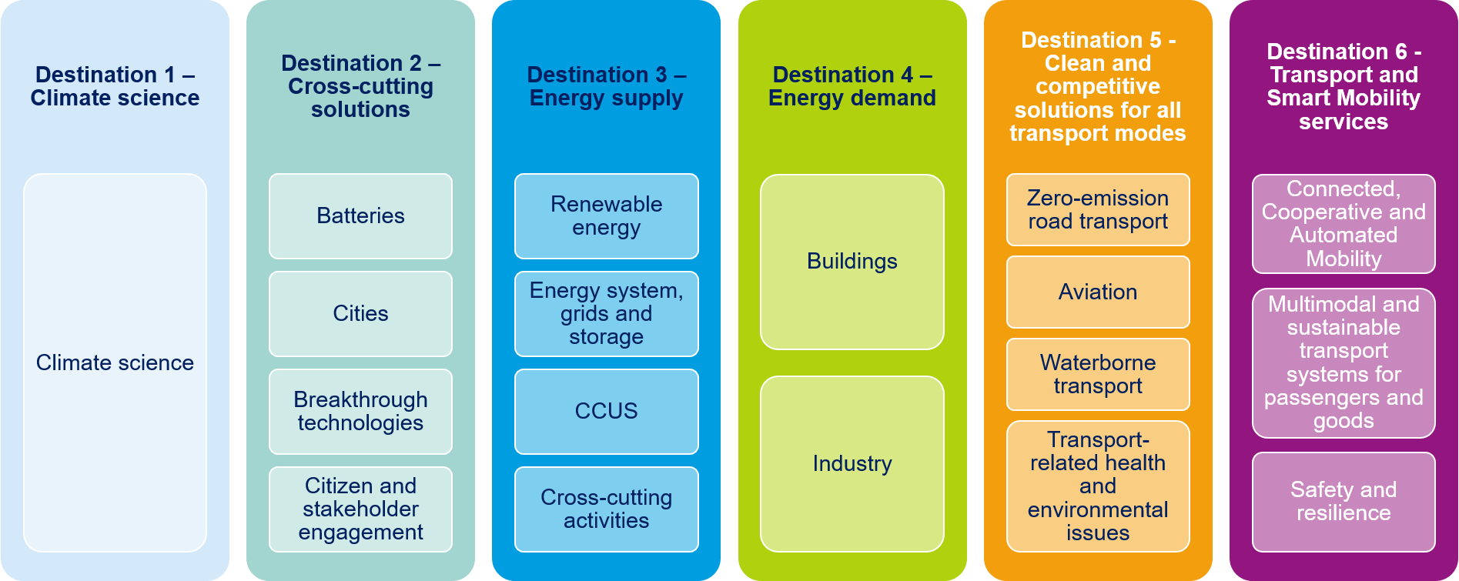
Cluster 5 – climate, energy and mobility
- 6 destinations = undergrupper
- Calls 2023-2024 open – ca. 180 calls
€15.3 mrd
Hydrogen topics
Hydrogen topics
Hydrogen topics

Slide 7
Horizon Europe
Total budget: 95,5 mrd. Euro
Pillar 1 Excellent Science (23,1 mrd. €) | Pillar 2 Global Challenges and European Industrial Competitiveness (51,3 mrd €) | Pillar 3 Innovative Europe (13,3 mrd. €)
European Research Council (ERC) | Clusters Health Culture, Creativity and Inclusive Society Civil Security for Society Digital, Industry and Space Climate, Energy and Mobility Food, Bioeconomy, Natural Resources, Agriculture and Environment Joint Research Centre - > Partnerships for all Clusters | European Innovation Council (EIC)
Marie Skłodowska-Curie Actions (MSCA) |  | European Innovation Ecosystems (EIE)
Research Infrastructures |  | European Institute of Innovation and Technology (EIT)
Widening Participation and Strengthening the European Research Area (3,2 mrd. €)
Widening participation and spreading excellence Reforming and Enhancing the European R&I system
ca. 50% of budget
Notes:
Hvordan jobber IN med Pilar 2:
Mobilisering - EU-rådgiver på RK førstelinje tjenesten ut til næringslivet​
Tett samarbeid med finansieringsrådgiver – viktig med kvalitetssikring av næringsaktøren​
Tett samarbeid med NCP eksperter (IN/Forskningsrådet) – analysere utlysninger, faglig dybdekompetanse ​
Tett dialog med forskningsmiljøer, offentlig sektor etc. – finne sterke konsortier som har lykkes tidligere

Slide 8
Call Identifier | Budget (EUR mill) | Publication | Deadline
HORIZON-JTI-CLEANH2-2024-1 | 113.5 | 17 January 2024 | 17 April 2024
*Note: calls are occurring yearly

Slide 9
1.
3.
RENEWABLE HYDROGEN | Electrolysis
RENEWABLE HYDROGEN | Electrolysis
RENEWABLE HYDROGEN | Electrolysis
RENEWABLE HYDROGEN | Electrolysis
RENEWABLE HYDROGEN | Electrolysis
3 Mio.€
4 Mio.€
4 Mio.€
4 Mio.€
10 Mio.€
HYDROGEN END-USES: TRANSPORT APPLICATIONS | Building blocks
HYDROGEN END-USES: TRANSPORT APPLICATIONS | Building blocks
HYDROGEN END-USES: TRANSPORT APPLICATIONS | Building blocks
HYDROGEN END-USES: TRANSPORT APPLICATIONS | Waterborne Applications
4 Mio.€
4 Mio.€
5 Mio.€
6 Mio.€
4.
HYDROGEN END-USES: CLEAN HEAT AND POWER | Fuel Cells
HYDROGEN END-USES: CLEAN HEAT AND POWER | Turbines, boilers and burners
5 Mio.€
4 Mio.€
2.
HYDROGEN STORAGE AND DITRIBUTION | Hydrogen Storage
HYDROGEN STORAGE AND DITRIBUTION | Hydrogen Storage
HYDROGEN STORAGE AND DITRIBUTION | Compression, Purification and Metering Solutions
HYDROGEN STORAGE AND DITRIBUTION | Compression, Purification and Metering Solutions
HYDROGEN STORAGE AND DITRIBUTION | HRS
3 Mio.€
4 Mio.€
6 Mio.€
6 Mio.€
8 Mio.€
5.
CROSS-CUTTING ISSUES | Sustainability, LCSA, recycling and eco-design
CROSS-CUTTING ISSUES | Sustainability, LCSA, recycling and eco-design
1,5 Mio.€
3 Mio.€
6.
H2 VALLEYS | H2 VALLEYS -Large scale
H2 VALLEYS | H2 VALLEYS- Sall scale
20 Mio.€
9 Mio.€

Slide 10
Maritime calls
Synergies: use and build on!
Previous funded EU projects (e.g. RH2IWER, FLAGSHIPS, H2Ports or EVERYWH2ERE)
Other partnerships (e.g. Zero Emission Waterborne Transport Partnership (ZEWT), Clean Aviation, Zero Emission Road Transport, a.o.)
HORIZON-JTI-CLEANH2-2024-02-05 | Demonstration and deployment of multi-purpose between road and application for airports, railways, and/or harbours
IA
TRL Start: 5
TRL End: 7
8 Mio. €
HORIZON-JTI-CLEANH2-2024-03-03 | Next generation on-board storage solutions for hydrogen-powered maritime applications
HORIZON-JTI-CLEANH2-2024-03-04 | Demonstration of hydrogen fuel cell-powered inland or short sea shipping
RIA
IA
TRL Start: 4 | TRL End: 6
TRL Start: 5 | TRL End: 7
5 Mio. €
6 Mio. €

Slide 11
Demonstration and deployment of multi-purpose between road and application for airports, railways, and/or harbours
HORIZON-JTI-CLEANH2-2024-02-05
IA / Max. 8 Mio. € / Deadline 17. Apr. 2024 / TRL up to 7
The aim of this topic is to demonstrate a multipurpose HRS able to supply a combination of aviation, rail and/or heavy-duty road applications. Combining these mobility ecosystems will stimulate the development of a regional hydrogen economy, creating a synergy with public and private actors across the hydrogen value chain (production, distribution, storage, and end-use). It is fundamental to develop and optimise HRS (especially for trains, marine and airport applications), situated on depots, with corresponding captive demand for large-scale hydrogen. This concept assumes the provision of pressurised gaseous and/or liquid hydrogen together with the development of appropriate and reliable systems for lifetime prediction.
The project results are expected to contribute to the following outcomes:
The deployment of hydrogen refuelling facilities for vehicles (ground support equipment and heavy-duty vehicles fleets) and captive fleets (buses, trains, etc.);
High public visibility with a growing number of trial and demonstration projects;
The development of new services and the HRS delivery platform;
Project results are expected to contribute to the following objectives and KPIs of the Clean Hydrogen JU SRIA:
Reduction of CAPEX: 1.5–4k€/(kg/d) (700bars), 0.65-2.5k€/(kg/d) (350bars), 1.5-4k€/(kg/d) (LH2);
Increased availability: 98% (700bars), 98% (350bars), 97% (LH2);
Hydrogen price: 3€/kg (700bars), 2€/kg (350bars), 3€/kg (LH2);
Annual maintenance cost: 0.5€/kg (700bars), 0.35€/kg (350bars), 0.5€/kg (LH2) ;
Increased reliability (mean time between failures): 72 days (700 bars), 144 days (350 bars), 216 days (LH2).

Slide 12
Cont.
Proposals should respond to the following technical requirements: (more requirements in original document!)
Develop high throughput stations for heavy duty vehicles fleets (trains, buses or trucks, aircrafts, maritime vessels, and associated ground support equipment), including 1 to 3,000kg/day capacity and individual fills of more than 200 kg (demonstration actions only, large-scale rapid filling remains a big challenge), expected in less than 20 minutes; more generally the station capacity should depend on filling station profile (e.g. hourly peak demand is usually around 7% of the daily mass dispensed (for trucks).
Develop digital models that capture refuelling data in aim to anticipate load curves in the HRS.
Reduce CAPEX and OPEX by implementing innovative technological components (e.g., compressors, cooling systems, dispensers) and optimising their integration into the design and operation of the HRS.
Facilitate the use of locally produced green hydrogen, e.g., by enabling low inlet pressure and flexible operation for intermittent renewable energies, or production by electrolysis or biomass;
Develop a pressurised and/or liquid hydrogen supply strategy;
Aim to standardise and industrialise HRS equipment and components while developing protocols for safe and reliable refuelling in partnership with OEMs and distributors;
Address technical certification and levels of education and awareness amongst regulators and other stakeholders
Support improved efficiency, with the goal of zero boil-off for LH2 and losses during hydrogen transfer, distribution, and, ultimately, across the whole hydrogen supply chain;
Quantify the costs incurred when operating an HRS.

Slide 13
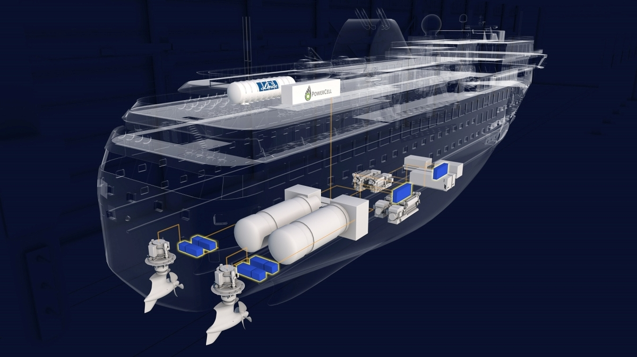
Next generation on-board storage solutions for hydrogen-powered maritime applications
HORIZON-JTI-CLEANH2-2024-03-04
RIA / Max. 5 Mio. € / Deadline 17. Apr. 2024 / TRL up to 6
This topic centres around maritime transport, with a view on a spill-over to rail and road applications of similar energy storage needs. The critical issues to be addressed for candidate fuel(s) for supplying pure hydrogen (5.0 fuel cell grade) on board of maritime vessels shall contribute to the following outcomes:
Contribute to the selection of most appropriate fuels for maritime transport across the widely differing operation requirements from short to deep sea shipping, thereby consolidating Europe's leading role in decarbonising maritime transport;
Ease the end-users' challenge of selecting the most suitable fuel for their new and retrofitted ships so that they can take well-informed decisions in the green energy (and fuel) transition.
Define optimal fields of application of the proposed storage technology considering the logistics and the mission of each category of maritime transport by the end of the project; additionally, the pathways to spill-over to heavy-duty rail and road transport systems must be elaborated;
Improve the operational capacity of storage systems to achieve performance according to the KPIs listed below;
Deployment of cost-effective hydrogen or hydrogen carrier fuel storage system for maritime, and if applicable, also other heavy-duty applications by 2030.
Project results are expected to contribute to the following objectives and KPIs of the Clean Hydrogen JU SRIA:
Hydrogen bunkering rate: 20 tonH2/h in 2030;
Tank volumetric Capacity system: 45 gH2/L (system) in 2030;
Tank CAPEX lower than 245 €/kgH2 in 2030.

Slide 14
Cont. (more requirements in original document!)
Projects are expected to focus on below-deck innovative inland and sea waterborne transport hydrogen storage systems beyond the State-of-the-Art in any of the well-established physical states and chemical compositions (CH2, LH2, NH3, LOHC, solid state carriers) as well as potential novel hydrogen carriers or combinations of technologies with the following characteristics:
Supply of pure hydrogen (5 point) to the propulsion system;
Vessel propulsion and auxiliary power systems requiring a hydrogen supply flow of minimum 30 kgH₂/h with a modular approach capable of achieving MW scale capacities;
Bunkering/refuelling expected during adequate and suitable timeslots within daily operation or at the beginning or end of daily service;
Below-deck, integrated onboard tanks to be filled directly (excluding exchangeable mobile tank systems (i.e., tank swapping)). The whole bunkering system needs to be addressed which means that the system boundary is on one side the feeding pipe for refueling and on the other one the pure hydrogen output to the conversion unit. Thus, everything in between is part of the system to be designed and trialed (i.e., LOHC+ and LOHC- tanks).
Proposals must elaborate on potential technology spillovers to other heavy duty means of transportation (road, trains, special vehicles, etc.), through scaling and/or adapting the proposed solutions or using parts (modules) of the larger system.
Projects should provide supporting evidence concerning:
Measures to deal with fuel spills and safety (fire, explosion, toxicity);
Energy efficiency and fossil carbon footprint from total fuel supply concept (well to hydrogen supply) based on the chosen hydrogen carrier and on-board storage solution;
The HAZID analysis as input to an Approval in Principle.

Slide 15
Cont. (more requirements in original document!)
The scope of the topic is to provide a full conceptual study of the proposed solution to storing hydrogen or a hydrogen carrier below deck of a vessel with high power propulsion needs (>500 kW) and high frequency operation. The scope further entails building a reference prototype for validating the concept, or several concepts in comparison, under real-world operating conditions.
The project should propose a storage technology which will be able to go beyond the state of art for on-board hydrogen storage with respect to the amount of energy stored, the space occupied per MWh of stored chemical energy, and the reduced shipping space (passengers/vehicles/containers), moving closer to current fuels properties and bunkering rates.
The project should provide a prototype suitable in principle for supplying a harbour vessel, short-sea vessel, offshore service vessel, or inland waterway propulsion module:
minimum 30 kg/hr of pure hydrogen supply;
storage capacity of minimum 200 kg hydrogen;
bunkering/refuelling time of less than 10 minutes per 100 kgH2.
The prototype is to be tested and validated under real-world operating conditions, including proof of safe handling and refilling over a meaningful number of cycles. The whole bunkering system needs to be addressed where the system boundaries are the feeding pipe for refueling and the pure hydrogen output:
Test duration of at least 300 h;
Minimum number of 50 cycles in a meaningful range of charge and discharge ratio complying with typical operating conditions;
Testing under relevant maritime operating conditions, including start-up from lower temperatures and peak power demand situations;
Evaluation of the thermal management requirements with regard to operating conditions;
Assessment of storage prototype lifetime/aging
The following activities are considered to be out of scope for this topic:
Technology and design developments concerning tank swap and mobile tank concepts; compression and liquefaction technologies; technologies which produce the hydrogen, such as electrolysers or ammonia synthesis; technologies that use the hydrogen, such as fuel cells, gas turbines, or internal combustion engines; technologies only aimed at terrestrial heavy-duty utilisation.

Slide 16
Demonstration of hydrogen fuel cell-powered inland or short sea shipping
HORIZON-JTI-CLEANH2-2024-03-03
IIA / Max. 6 Mio. € / Deadline 17. Apr. 2024 / TRL up to 7
This topic aims to demonstrate in its operational environment a broad hydrogen based waterborne transport ecosystem, showing the feasibility and benefits of integrating hydrogen and hydrogen carriers into this hard to abate sector. The overarching goal is to address the ability to safely bunker hydrogen (pure or in terms of a hydrogen carrier), to store it on board and to consume it for propulsion in a waterborne environment. Such solutions should address bunkering, on-board storage, power conversion and propulsion and as well consider, the current industrial standards in manufacturing, transportation, storing and safe handling of hydrogen or the hydrogen carrier involved. The use of Internal Combustion Engines is excluded.
The demonstration project should contribute to:
Reducing GHG and local emissions from waterborne transport in line with prevailing targets;
Enabling and facilitate further deployment in hydrogen-powered shipping, ensuring safety underpinned by the necessary onshore norms and regulations (protocols and standards);
Developing a European supply chain and thereby consolidating the European industry's competitiveness in zero emission waterborne transport;
If possible, integrating into the demonstrator a prototype developed in previous project related to the application of FC modules to heavy duty applications such as e.g. Standard-Sized Heavy-duty Hydrogen (StaSHH)
Project results are expected to contribute to the following objectives and KPIs of the Clean Hydrogen JU SRIA:
In-ship system CAPEX [€/kW]: 2,000 in 2024 and 1,500 in 2030;
Expected system lifetime [h]: 40,000 in 2024 and 80,000 in 2030;
NO_{x} emissions not exceeding 25 ppm of the exhaust gas stream and 30 mgNO_{x}/MJ_{fuel;}

Slide 17
Cont. (more requirements in original document!)
Moreover, the results are expected to comply with the following requirements:
Demonstration under realistic end user operation of at least 1000 h, preferably longer;
Minimal on-board energy storage for operational autonomy of 48h (2 days);
Documentation of safe, efficient on-board storage and integration of hydrogen /hydrogen carrier;
Integration of the chosen on-board storage solutions below the vessel deck, or swappable fuel tank containers on deck appropriate for a scale of several hundreds of kilos to tons;
Installing the associated high-capacity refuelling infrastructure into ports.
Project proposals should address demonstration of fuel cell (internal combustion engines are excluded) of hydrogen powered inland or short sea vessels utilising Fuel Cells under the following considerations:
Development and demonstration of a hydrogen ecosystem with at least one port including hydrogen (carrier) logistics, and suitable integrated refuelling/bunkering solution;
Provision of zero-carbon fuels (hydrogen or its carriers), shore-based infrastructures;
Selection of a suitable ship segment and technical concept for the demonstration activity, including an adequate propulsion power level for the application;
Secure the port(s) approval processes for hydrogen / hydrogen-based fuels bunkering and construct the bunkering infrastructure solution;
Establish the technical and economic feasibility for replication and scale up in European ports.

Slide 18
Small + Large-scale Hydrogen Valley
HORIZON-JTI-CLEANH2-2024-07-02 + HORIZON-JTI-CLEANH2-2024-07-01
IA / Max. 9 Mio€ (small) & 20.Mio € (large) / Deadline 17. Apr. 2024 / TRL up to 8
A Hydrogen Valley typically require a multi-million EUR investment and cover all necessary steps in the hydrogen value chain, from production (and often even dedicated renewable electricity production) to subsequent storage and its transport & distribution to various end-uses. It serves more than one end sector or application in transport, industry and energy.
Aim: deploying 100 Hydrogen Valleys worldwide by 2030.
Proposals should respond to the following technical requirements:
The proposed solution should provide energy flexibility and improve the regions’ system resilience through the use of renewable hydrogen
Produce at least 4,000 tonnes of renewable hydrogen per year using new hydrogen production capacity
At least two hydrogen applications from at least two different sectors should be part of the project, with a clear focus on energy, industry and transport sectors.
Production of hydrogen with a LCA GHG intensity ratio lower than 3.38 tCO2e for each ton produced
Demonstration of how financial viability is expected to be reached after two years of operation.

Slide 19
Draft: 20x calls 2024 EU's Funding & Tender portal: klikk her
HORIZON-JTI-CLEANH2-2024-01-01 | Innovative proton conducting ceramic electrolysis cells and stacks for intermediate temperature hydrogen production
HORIZON-JTI-CLEANH2-2024-01-02 | Advanced anion exchange membrane electrolysers for low-cost hydrogen production for high power range applications
HORIZON-JTI-CLEANH2-2024-01-03 | Development of innovative technologies for direct seawater electrolysis
HORIZON-JTI-CLEANH2-2024-01-04 | Development and implementation of online monitoring and diagnostic tools for electrolysers
HORIZON-JTI-CLEANH2-2024-01-05 | Hydrogen production and integration in energy-intensive and speciality chemical industries in a circular approach to maximise total process efficiency and substance utilisation
HORIZON-JTI-CLEANH2-2024-02-01 | Investigation of microbial interaction for underground hydrogen porous media storage
HORIZON-JTI-CLEANH2-2024-02-02 | Novel large scale aboveground storage solutions for demand-optimised supply of hydrogen
HORIZON-JTI-CLEANH2-2024-02-03 | Demonstration of hydrogen purification and separation systems for hydrogen-containing streams in industrial applications
HORIZON-JTI-CLEANH2-2024-02-04 | Demonstration of innovative solutions for high-capacity, reliable, flexible, and sustainable hydrogen compression technologies in commercial applications
HORIZON-JTI-CLEANH2-2024-02-05 | Demonstration and deployment of multi-purpose between road and application for airports, railways, and/or harbours
HORIZON-JTI-CLEANH2-2024-03-01 | BoP components, architectures and operation strategies for improved PEMFC system efficiency and lifetime
HORIZON-JTI-CLEANH2-2024-03-02 | Scaling up Balance of Plant components for efficient high-power heavy-duty applications
HORIZON-JTI-CLEANH2-2024-03-03 | Next generation on-board storage solutions for hydrogen-powered maritime applications
HORIZON-JTI-CLEANH2-2024-03-04 | Demonstration of hydrogen fuel cell-powered inland or short sea shipping
HORIZON-JTI-CLEANH2-2024-04-01 | Portable fuel cells for backup power during natural disasters to power critical infrastructures
HORIZON-JTI-CLEANH2-2024-04-02 | Improved characterisation, prediction and optimisation of flame stabilisation in high-pressure premixed hydrogen combustion at gas-turbine conditions
HORIZON-JTI-CLEANH2-2024-05-01 | Guidelines for sustainable-by-design systems across the hydrogen value chain
HORIZON-JTI-CLEANH2-2024-05-02 | Development of non-fluorinated components for fuel cells and electrolysers
HORIZON-JTI-CLEANH2-2024-07-01 | Large-scale Hydrogen Valley
HORIZON-JTI-CLEANH2-2024-07-02 | Small-scale Hydrogen Valley

Slide 20
Criteria and information:
General for Horizon Europe and partnerships:
Minimum three partners from three countries – Norway = «country»
Check TRL level- both start and expected end
Look at the bigger picture – think outside the box reg. partners, customers, project angel, a.m.
Crossover competencies needed?
Show synergiens with other EU projects or programes
Check policies, strategies and guidlines
Role in a consotium: leader vs particpaint
Research Innovation Action and Innovation Action – coverage for companies = 70%, coverage for NGO’s, clusters, R&D instituts = 100%
Specific for EU’s partnships:
Max funding per call – lump sum: Applications exceeding the funding budget will not be evaluated
Minimum one consortium partner must be member in Hydrogen Europe or Hydrogen Europe Research (same accounts for other partnerhsips)
Equipment and material costs: Purchases of equipment, infrastructure or other assets used for the action must be declared as depreciation costs. However, for the following equipment, infrastructure or other assets purchased specifically for the action (or developed as part of the action tasks): electrolyser, its BoP, hydrogen pipeline network, and any other hydrogen related equipment essential for the implementation of the project (e.g. hydrogen storage), costs may exceptionally be declared as full capitalised costs.

Slide 21
Governing board
6 industry grouping
1 research grouping
1 EC
€1bn
Members
States Representative Group (SRG)
Åse Slagtern, RCN (member)
Tore Grunne, OED (alternate)
€1bn
Stakeholders Group
Industry grouping 400+ companies & national associations ExCo: - Jon André Løkke, NEL (chair) - Hege Rognø, Equinor Members: Equinor, Hydrogenpro ASA, Hystar AS Møre og Romsdal fk., NEL (DK), Norwegian Hydrogen Forum, Scatec ASA, Fortsecue, Norwegian Hydrogen, Stavanger Region European Office TECO2030, YARA
Research grouping 500+ scientists 131 univ. & RTOs, 29 countries Steffen Møller-Holst, Sintef, TC chair Members: Sintef,
IFE NORCE, NTNU, Sintef Ocean
Clean Hydrogen Partnership- webpage
Strategic Research and Innovation Agenda (SRIA)
Annual Work Programme
check members
check members

Slide 22
Clean Hydrogen – synergies & collaboration
Cluster 4: Digital, Industry & Space
Clean steel – low-carbon steelmaking
Processes4Planet
Cluster 5: Climate, Energy & Mobility
Clean Aviation
Europe’s Rail
Zero-emission waterborne transport
Zero-emission road transport
Clean Energy Transition
Institutionalised Partnerships (Art 185/7)
Co-Programmed
Co-Funded

Slide 23
Support from Innovation Norway and the Norwegian Research Council
Use the NCP network (IN & RCN) and EU advisors in your cluster
– big network + remember: has foreign offices in Europe
Prosjektetablerningstøtte (PES) + PNO services – The Norwegian Research Council link
EU’s Funding & Tender portal link
PIC – nummer (Participant Identification Code) link
Courses and advisory
Communication and social Media
National Funding
NCP’s in Norway and network

Slide 24
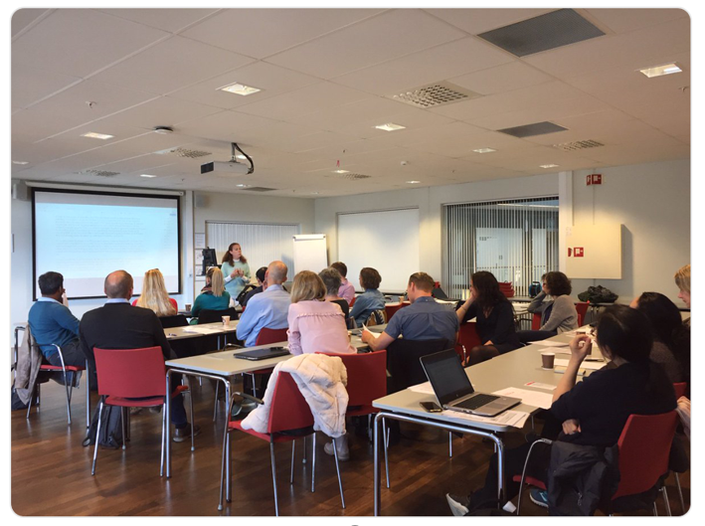
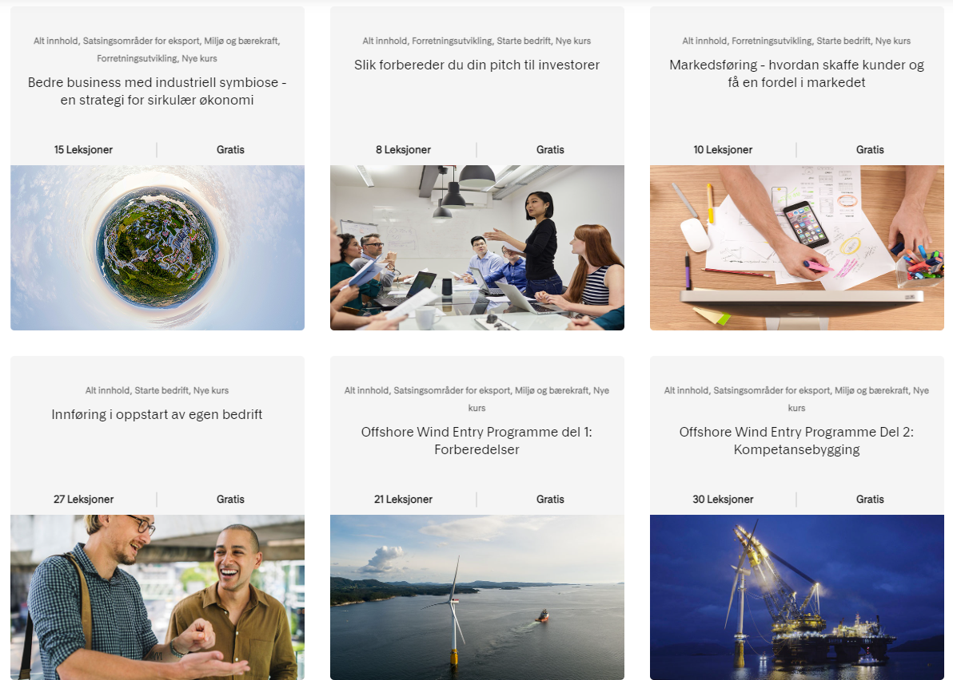
Courses from IN and RCN
Over 2000 x partisipants yearly:
Introduction to Horizon Europe
Application writing
Consortium contratcs and advisory
Project management of EU projects
Financial audits
Innovation Norway Competence Center
Digital courses with different topics. e.g. IP- Strategy, Growth & Scaling, Businessmodelling Internationalization, a.m.
RCN courses - here:
IN’s Compentence Center - here:

Slide 25
Økonomiske støtteordninger
PES - Støttegrensermaksimum kr 1 000 000 (bagatellmessig støtte)
Prosjektetableringsordningen (PES) skal bidra til at søknader med norsk deltakelse i Horisont Europa har høy kvalitet slik at norsk potensial blir tatt ut så godt som mulig
Søk så tidlig som mulig – helst så snart et prosjektforslag begynner å ta form – og seinest fire uker før EU-fristen. Skal du koordinere et samarbeidsprosjekt, må du ta kontakt med en NCP seinest 12 uker før EU-fristen
Krav til prosjektansvarlig: Den prosjektansvarlige organisasjonen som står som prosjektansvarlig i søknadsskjemaet, må ha godkjent at søknaden sendes inn. Det forutsettes at prosjektansvarlig oppfyller formelle krav som stilles for å delta i EU-prosjektforslag.
Krav til prosjektleder: Prosjektleders faglige kompetanse og egnethet til å gjennomføre prosjektet vil bli vurdert. Det er ingen formelle krav til prosjektleders kvalifikasjoner.
Midlene kan gå til å dekke kostnader knyttet til reiser, deltakelse på møteplasser, til posisjonering og timer og innkjøp av tjenester for å utarbeide prosjektforslag. Alle støttebeløpene er maksgrenser. Støtte til hver PES-søknad vurderes individuelt.
EU-prosjektforslaget må oppnår en karakter som tilsvarer terskelverdi ("threshold") eller bedre.
PNO –gratis konsulenthjelp- avtale med NFR
hjelp til utvikling av Horisont Europa-strategi
mentorhjelp og ideutvikling til best mulig Horisont Europa søknad
hjelp med å finne riktige partnere til prosjektet
gjennom individuelle møter avdekke spesifikke behov, ambisjoner og forventninger
identifisere utlysninger og finansieringsmuligheter som passer med ditt prosjekt
gjennomlesning og kommentering av søknaden
IN virkemidler som forberedelse/supplement
Innovasjonstilskudd, innovasjonskontrakt o.a. kan være risikoavlastende og forbedrede prosjektet/selskapet
Søknader til IN og EU kan går i parallell
EU trumfer IN
Kan samkjøres dersom ikke samme aktiviteter er finansiert av norsk og europeiske skattepenger

Slide 26
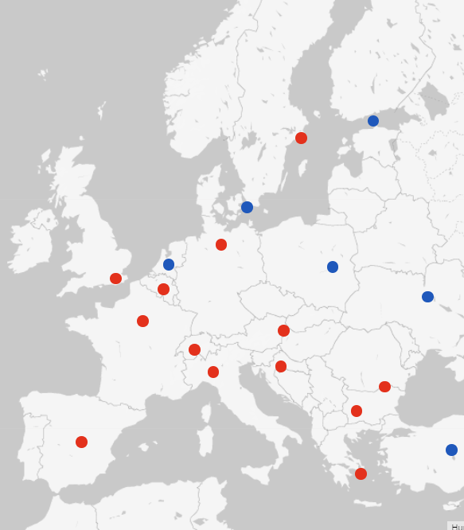
NCP’s and consortium building
NCP’s are working for you
NCP’s in RCN and IN work both top down and bottom up
«Spies» and networkers
Sparringspartner on call text
Support building consortias
Network towards sister organisations
Network towards R&D insitutions and companies in Europe
Innovation Norway services as supplement
IPR advisory, businessmodelling, foreign offices, customer and partner search, market reports, internationalisation, a.m. can be building the foundation towards EU success
Dialog with government and officals (Norway and EU)
Dialog with programme committees
Dialog with working groups in the EU system

Slide 27
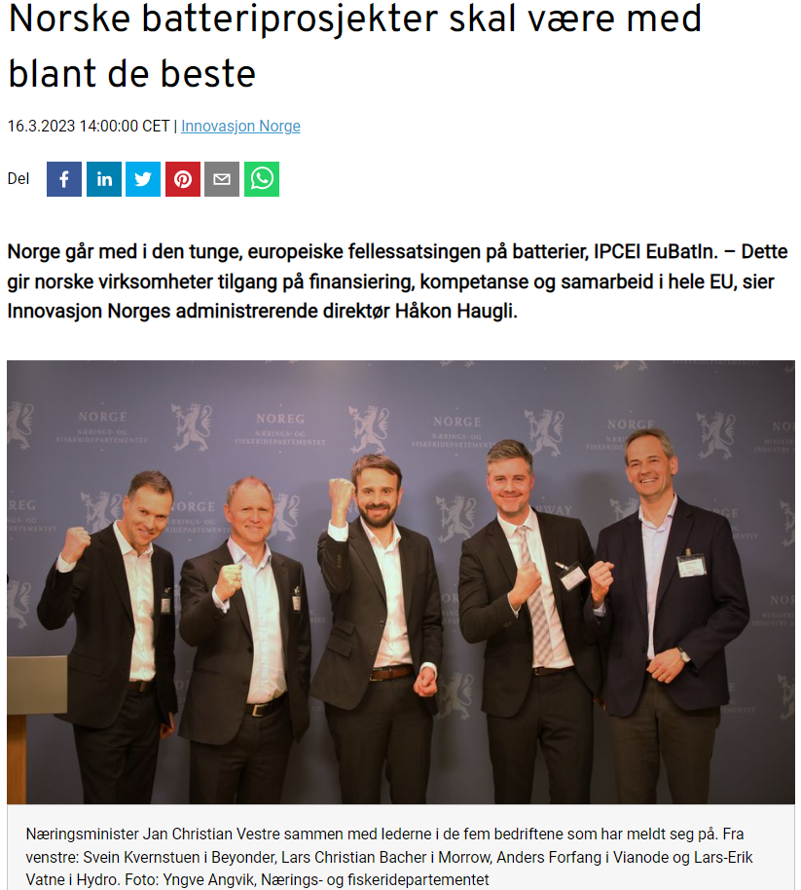
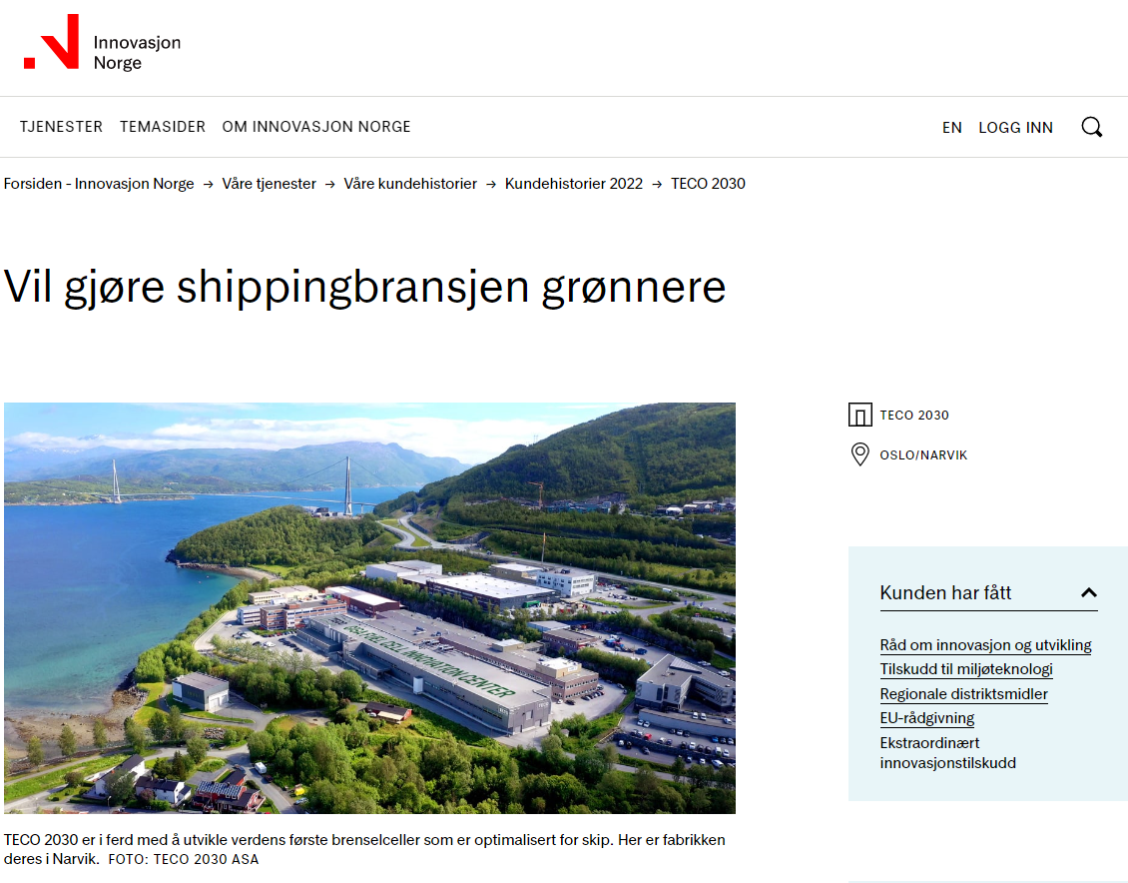
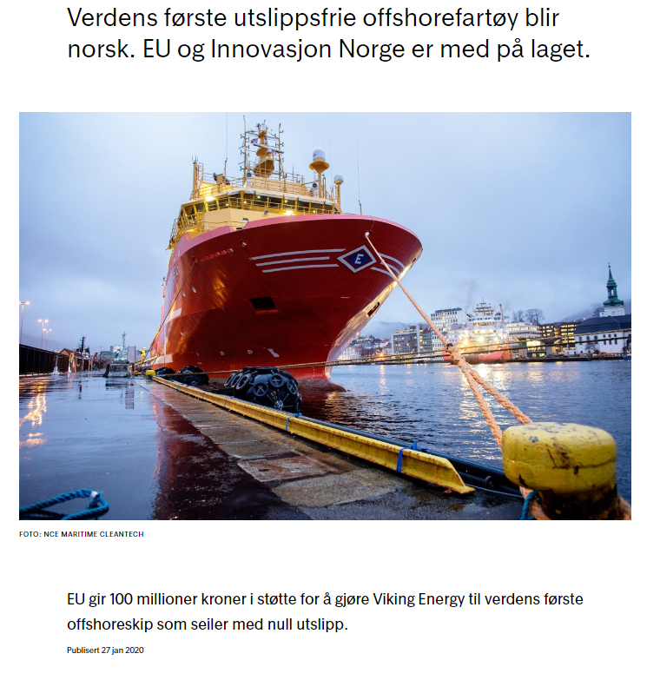
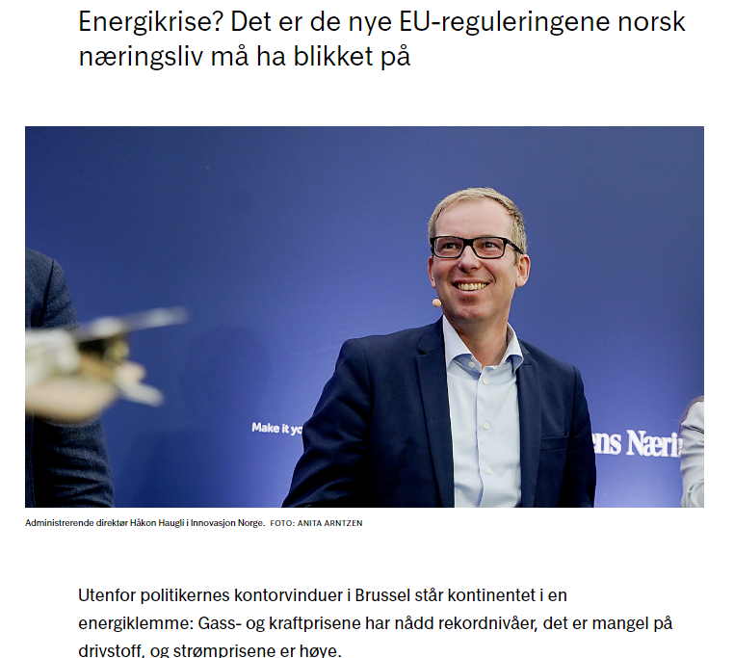
Communication

Slide 28
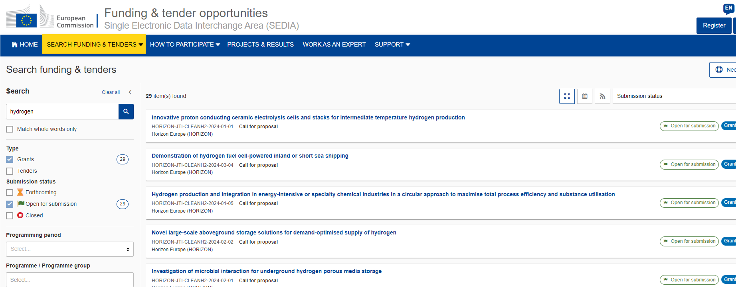
EU's Funding & Tender portal: klikk her

Slide 29
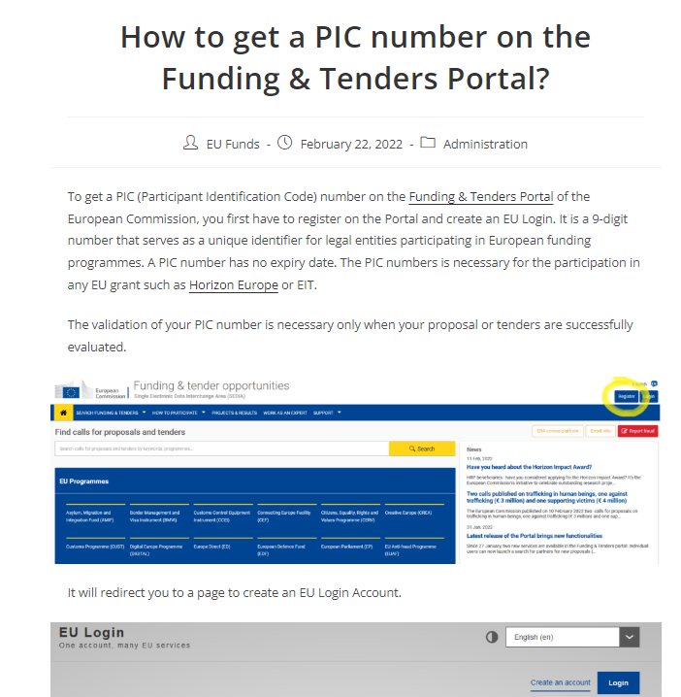
PIC – number
(Participant Identification Code) link

Slide 30
National calls for funding of R&D and commercialisation activites for hydrogen actors

Slide 31
Innovation Norway financial schemes for Norwegian H2 actors – no application deadlines
Miljøteknologiordningen
Tilskudd til utvikling, pilot og demonstrasjon av ny miljøteknologi.
Det gjelder innovative produkter eller prosesser som løser et miljøproblem. Miljøeffekten må være vesentlig.
Innovasjonskontrakter
Tilskudd til leverandørbedrifter som har et innovasjonsprosjekt i et forpliktende samarbeid med en pilotkunde.
Pilotkunden bidrar aktivt i utviklingsprosjektet, slik at den endelige løsningen treffer best mulig på markedets behov.
Risiko- og innovasjonslån
Delfinansiering av investeringsprosjekter som handler om etableringer, nyskaping, internasjonalisering, kapitalstyrking, vekst og omstilling.
Vekstlån til internasjonalisering og eksport
Grønt vekstlån
Tilskudd
Lån
*- other advisory services e.g. IPR ,internationalisation etc. and programmes such as Accelerators a.o. are available too
Notes:
Beskriv prosjektet deres – vi vurderer mulige finansieringsløsninger

Slide 32
Relevant 2024 national calls for funding of R&D on hydrogen
 | Joint Call for Proposals with Brazil for Research and Technology Development in the Industrial Sector | Knowledge-building Project for Industry | Innovation projects for the industrial sector
Partners | The Project Owner (company) must carry out the project together with a Brazilian company. Research organizations can be included as R&D providers | Requirement for cooperation with min. 2 partners from the business sector that contribute with research funding | Applicant is a private company in cooperation with Partnering companies. Research group(s) (as suppliers of R&D)
Open to | Hydrogen and hydrogen-based energy carriers, wind power, solar energy and petroleum | All thematic areas as defined in RCN Portfolio plans for Energy, transport and low emission and Petroleum. | All thematic areas as defined in RCN Portfolio plans for Energy, transport and low emission and Petroleum.
24 April
13 March
TBD
Joint call Brazil and Norway: Fellesutlysning med Brasil for forskning og teknologiutvikling i næringslivet (forskningsradet.no)
KSP 2024: https://www.forskningsradet.no/utlysninger/2024/kompetanseprosjekt-naringslivet/

Slide 33
Takk
Spørsmål?

